Slide 1
Levels Of Testing

Slide 2
Unit Testing
Integration Testing
System Testing
User Acceptance Testing

Slide 3
Levels Of Testing
Software Testing is done at various stages of SDLC (comprising varied scope) to ensure that the software/product meets the requirement specifications at each stage.
Scope of testing at each level is different.
Various Levels of Testing are:
Unit Testing (Component Testing)
Integration Testing
System Testing
User Acceptance Testing

Slide 4
Unit Testing
Individual units of source code are tested to determine if it conforms to the technical specification document.
The smallest unit of code will be tested. For instance, individual program, function stored procedure.
In object-oriented programming, the smallest unit is a method, which belongs to base/super class/abstract class/derived child class.
The field validations, presence of menu controls & layout of the page are tested with different inputs after coding /UI Design.
Code is executed & tested to ensure that each line of code is run for the required unit test cases.

Slide 5
Unit Testing
Lowest level of testing
Part of the construction phase of the SDLC
Done once coding for the unit or program is completed
Generally performed using White Box Testing

Slide 6
Unit Testing
Who performs it?
Unit Testing is generally performed by software developers themselves or their peers
Test Artefacts created are:
Unit Test case documents
Unit Test Logs
Unit Testing Defect report

Slide 7
Unit Testing
Entry Criteria :
Unit Test Plan is baseline
Coding is completed
Code is reviewed and baseline (optional)
Exit Criteria :
100% statement coverage
Acceptable (predetermined) levels of code coverage obtained

Slide 8

Integration Testing
Integration testing is done to check the dataflow between the modules(components or units) or between the systems.
Integration testing is categorized into two:
Unit Integration Testing
System Integration Testing

Slide 9
Unit Integration Testing
The individual software modules/pages are integrated and tested for their functionalities as one single unit.
Ensures that the individual units work together as a whole and the data flows (back and forth) across the units as per the requirement specification.
Done after two or more programs or application components have been successfully unit tested.
Any black box, white box testing methodology can be used to test.
Also referred to as Assembly Testing and API Testing.

Slide 10
Unit Integration Testing
Entry Criteria
Integration Test Plan is base-lined
Code and unit testing is completed
Unit test errors are fixed and verified
Code is reviewed and base-lined
Exit Criteria :
100% thread coverage achieved
There are two types of integration testing
Incremental testing
Continuous testing of an application as new functionality is added
Non-incremental testing
Testing of combined parts of an application to determine if they function together correctly

Slide 11
Unit Integration Testing - Approaches
Depends upon organization we have different approaches which are
Top-Down Approach
Bottom-Up Approach
Sandwich Approach
Big-Bang Approach

Slide 12
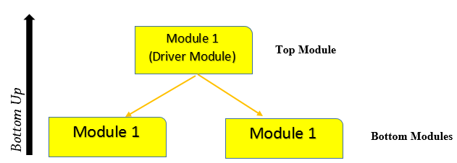
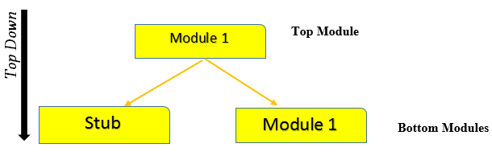
Top-Down & Bottom-Up Approach
Notes:
Notes:
Top-Down Approach:-
An approach where top level units are tested first and lower level units are tested step by step after that.
Used when top down development approach is followed.
Test Stubs are needed to simulate lower level units which may not be available during the initial phases.
Bottom-Up Approach:-
An approach where bottom most units are tested first and then move upwards step by step.
Used when bottom up development approach is followed.
Test Drivers are needed to simulate higher level units which may not be available during the initial phases.

Slide 13
Stubs And Drivers
Stubs are dummy pieces of code.
On the other hand, drivers are the ones, which are the "calling" programs.
Drivers are dummy code used in bottom up testing approach.
Drivers are used when the sub modules are ready but the main module is still not ready.

Slide 14
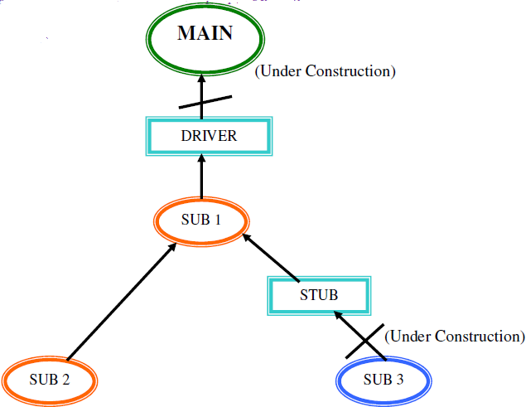
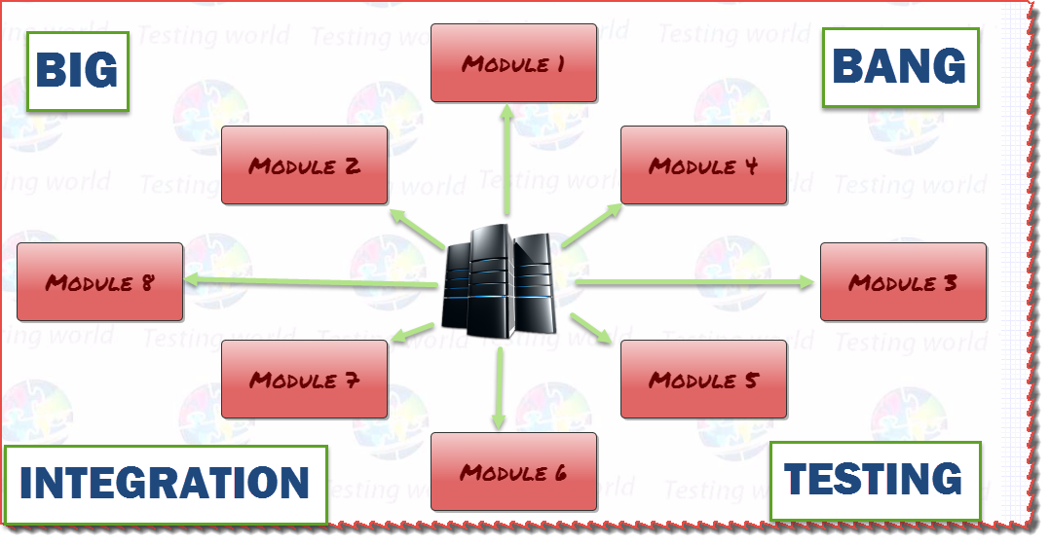
Big-Bang & Sandwich Approach
Sandwich Approach
Notes:
Notes:
Big-Bang Approach:-
An approach where all or most of the units are combined together and tested at one go.
Used when the testing team receives the entire software in a bundle.
Most of the defects can be uncovered early in the test process.
Sandwich Approach:-
It is an approach to combine top down testing with bottom up testing.
It requires both Stub & Driver

Slide 15
Unit Integration Testing
Who performs it?
Either Developers themselves or independent Testers
Test Artefacts created are:
Component Integration Test case documents
Component Integration Test Logs
Component Integration Testing Defect report

Slide 16
System Testing
Testing of Complete, integrated system/software.
Performed on the entire system where the system is validated against the Functional Requirement Specification(s) (FRS) and/or a System Requirement Specification (SRS).
Black box Testing is preferred to carry out the system testing.
Defects that are missed to be caught in the unit, Assembly testing are uncovered.
Some of the scenarios will be covered for test only during system testing.
Individual modules may work as desired but may fail as a system – this can be uncovered during system testing.

Slide 17
System Testing
Who performs it?
Performed by an independent Testing team
Test artefacts created are :
System Test case documents
System Test Logs
System Testing Defect report

Slide 18
System Integration Testing
Carried out to check if the system works in conjunction with the other systems/interfaces(as below) and the data flows across them as desired:
LAN/WAN, communications middleware
Other internal systems (billing, stock, personnel, overnight batch, branch offices, other countries)
External systems (stock exchange, news, suppliers)
Intranet, internet / www
Third party packages
Electronic data interchange (EDI)
Printers
Generally performed after System Testing or in parallel.

Slide 19
System Integration Testing - Approaches
Risk Based:
Identify the System Integration points that are critical to the business
Prioritize them and test sequentially
“Divide and conquer”:
Test the outside first (at the interface to your system, e.g. test a package on its own)
Test the connections one at a time first (your system and one other)
Combine incrementally - safer than “big bang” (non-incremental)

Slide 20
System Integration Testing—Methods
Who performs System Integration Testing?
Independent testing team
Test artefacts created are:
System Integration Test cases
System Integration Test logs
System Integration Testing defect report

Slide 21
User Acceptance Testing
Testing done by end users allowing them to verify day- to-day business scenarios and validate if the system developments satisfies their needs.
Validates if the software meets a set of agreed acceptance criteria.
Validates if the application is fit for deployment.
Performed generally in the customer’s(more close to the actual) environment.
Performed after the ST, SIT, or in parallel.
Helps assure that the Software application meets the needs of the end users/business or not.
Helps determine whether to accept a software product.

Slide 22
User Acceptance Testing
Who performs Acceptance Testing?
Customers/Business Users/independent testing team (with high business knowledge) which is identified to augment the customer’s requirements.
Test artefacts created are:
Acceptance Test cases
Acceptance Test logs
Acceptance Testing defect report

Slide 23
User Acceptance Testing
It will be performed in two ways
Alpha Testing
Beta Testing
Notes:
Notes:
Alpha Testing:
Alpha Testing is done by the client at developers environment.
It will be carried out with the help of virtual environment
Beta Testing:
It is carried out by the end users/ client at real environment(production environment)
It will be get carried out at the place where application will be get deployed

Slide 24
People Who Do The Testing
Users
Customers
Testers
Developers
All Stakeholders

Slide 25
Levels Of Testing
1. Which of these levels of testing is typically done by an independent test team?
Unit Testing
Integration Testing
System Testing
User Acceptance Testing
Notes:
Answer: Integration Testing

Slide 26
Levels Of Testing
2. During which of these levels of testing, is the knowledge of programming languages required?
Unit Testing
Integration Testing
System Testing
User Acceptance Testing
Notes:
Answer: Unit Testing

Slide 27
Levels Of Testing
Unit Testing
Integration Testing
System Testing
User Acceptance Testing
3. Which testing is used to check data-flow between the applications
Notes:
Answer: Integration Testing

Slide 28
Levels Of Testing
Unit Testing
Integration Testing
System Testing
User Acceptance Testing
4. In which type of testing client is involved
Notes:
Answer: User Acceptance Testing

Slide 29
Levels Of Testing
Unit Testing
Integration Testing
System Testing
Alpha Testing
Beta Testing
5. Which type of testing is getting conducted in production Environment
Notes:
Answer: Beta Testing

Slide 30
Unit Testing
Integration Testing
System Testing
User Acceptance Testing

